Slide 1
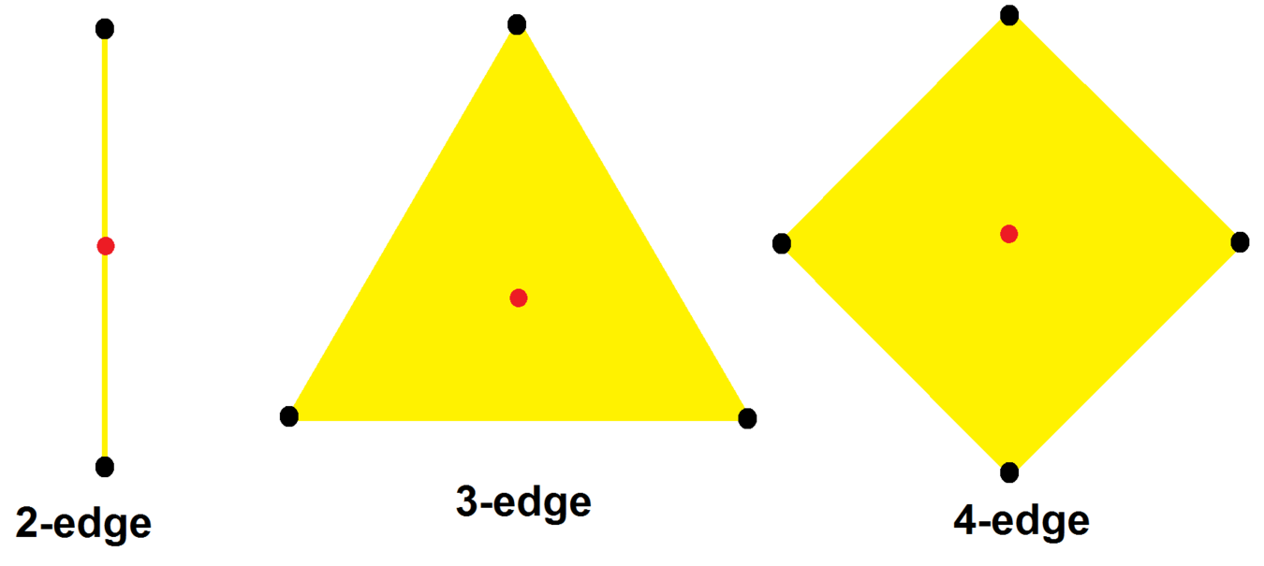
Complex polygons
Complex polygons:
each dimension is changed from a real to a complex number.
Real edge: R¹
Complex edge: C¹ (from Wikipedia)
V₁
V₂
mirror

Slide 2
Complex polygons
Real square in R²:
4 vertices: (±1, ±1)
4 edges:
X1 = 1, X1 = -1, X2=1, X2= -1
Complex square in C²:
16 vertices: (±1±i, ±1±i)
8 complex 4-edges:
Z1 = ±1±i, Z2 = ±1±i

Slide 3
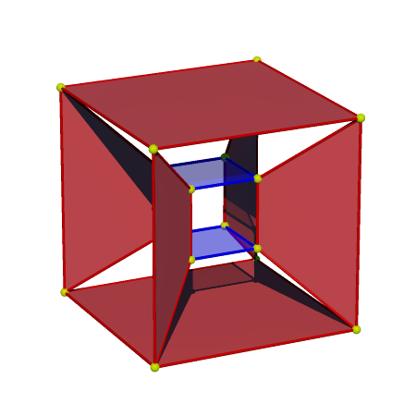
Complex square
16 vertices: (±1±i, ±1±i)
8 complex 4-edges:
Z1 = ±1±i, Z2 = ±1±i
How to visualize?
Real representation: C² -> R⁴
(Z1, Z2) -> (Re(Z1), Im(Z1), Re(Z2), Im(Z2))
Tesseract
16 real vertices = 16 complex vertices
Eight square faces = eight 4-edges
Omit the other 16 faces
Each edge has 4 vertices. Each vertex has 2 edges
1D real edges, 3D cells don’t have any meaning

Slide 4
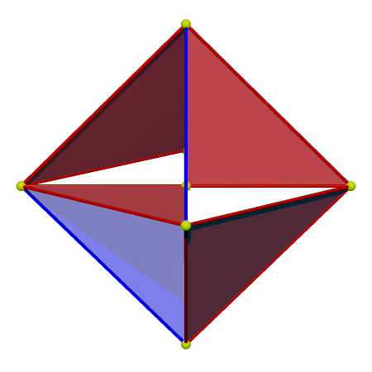
Regular complex polygons:
The complete numeration: done by Shephard and Coxeter.
3 Infinite series + 19 sporadic non-star polygons
Visualization: not all done, especially the bigger shapes
Some of them correspond to regular 4-polytopes. Some not.
3{3}3:
Each edge has 3 vertices
Each vertex has 3 edges
Vertices: 16-cell
3D print

Slide 5
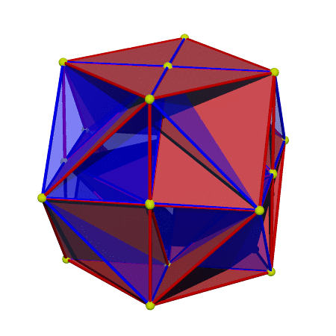
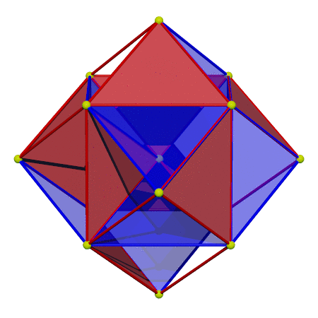
3{4}3, 4{3}4: vertices coincide with 24-cell (3d print)

Slide 6
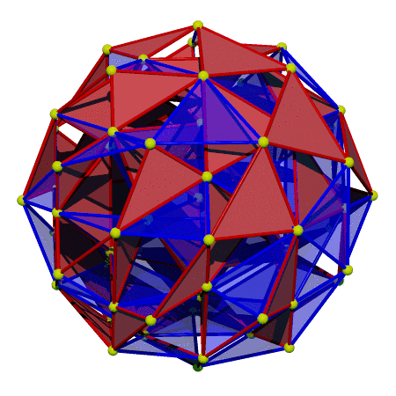
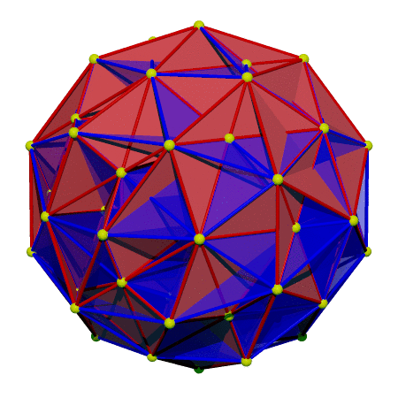
3{5}3, 5{3}5: vertices coincide with 600-cell

Slide 7
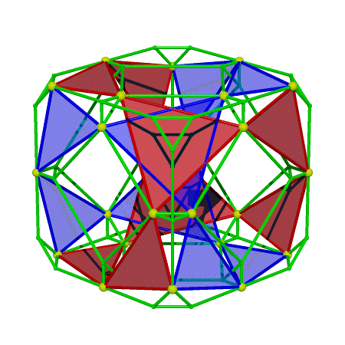
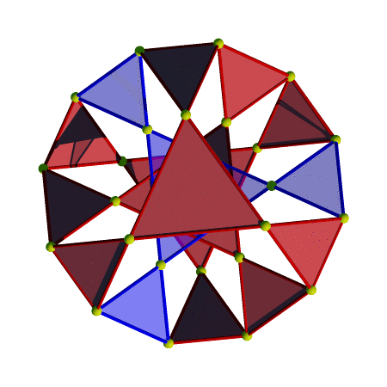
3{6}2: (3d print)
Vertices based on a bitruncated tesseract
Depth of truncation doesn’t generate the uniform 4-polytope

Slide 8
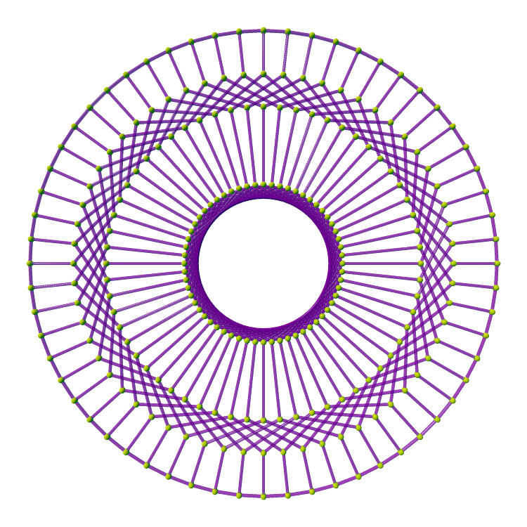
2{10}3
Should have H4 symmetry. I don’t know which 4-polytope yields vertices
2D projection: 60-fold symmetry

Slide 9
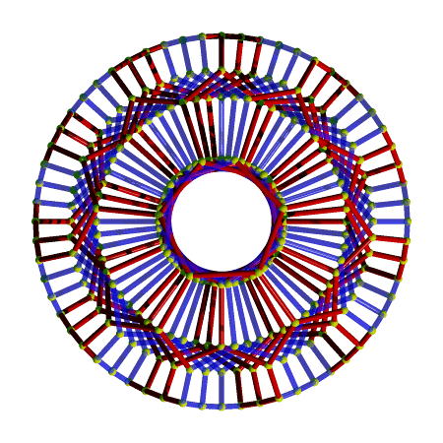
2{10}3
Should have H4 symmetry. I don’t know which 4-polytope yields vertices
2D projection: 60-fold symmetry

Slide 10
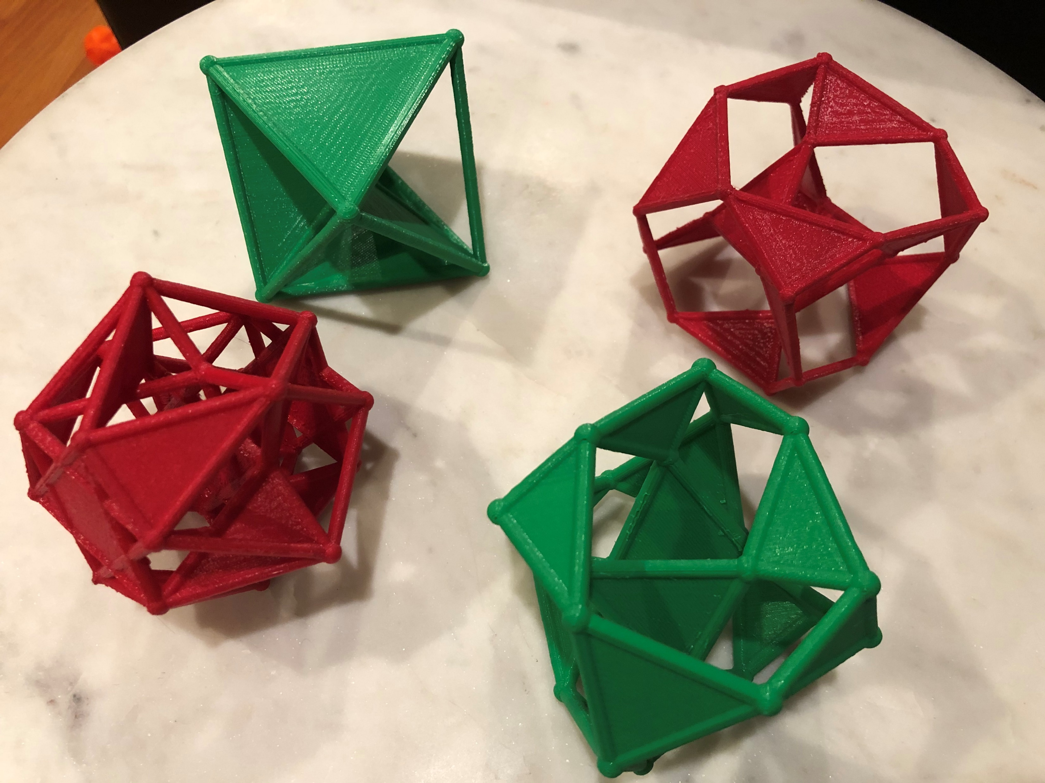
3D printed models: 3{3}3, 3{6}2, 3{4}3

Slide 11
Lots of work needed to explore the new shapes
Images and source code in
https://github.com/nanma80/complex-polytopes
Questions about complex polytopes?

